Slide 1

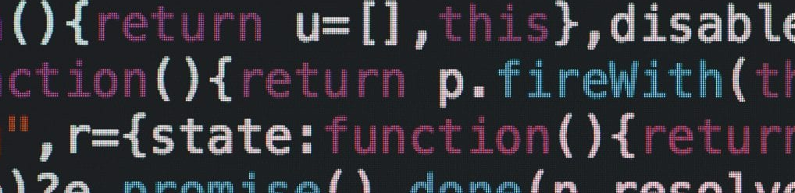
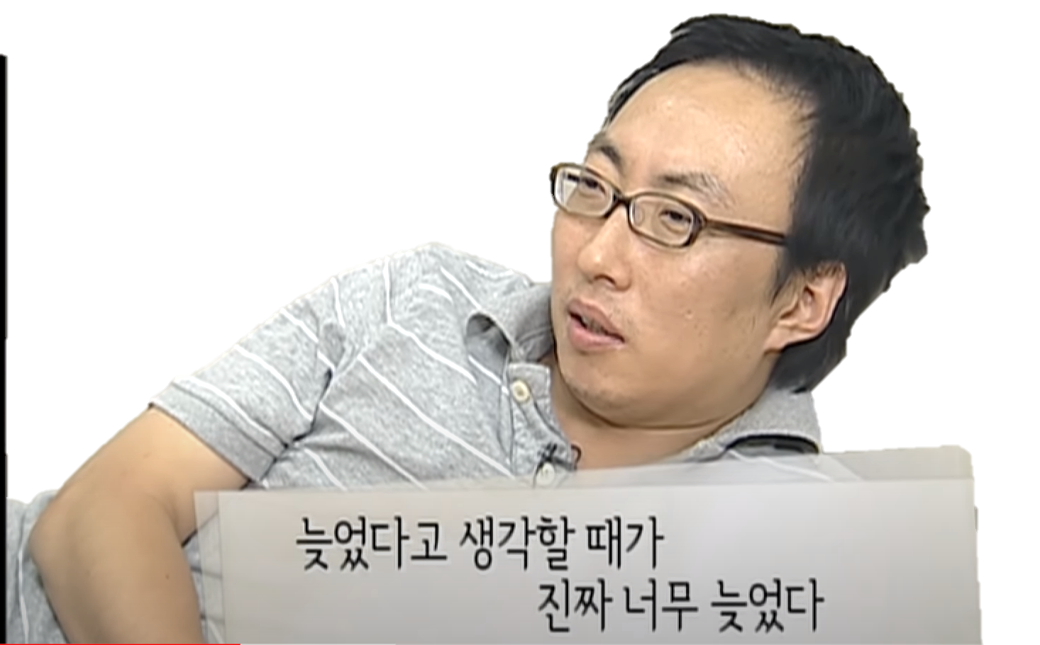
Instagram @ba_eb_ae
GitHub @Rlearnchan

